Slide 1


Software Project Management
Budget

Slide 2

What is a Budget?
A budget is a planning tool that ensures you will have the resources necessary to successfully accomplish your objectives
A budget can
Cover a short time span Take a long-term perspective Focus on a specific project
Account for income and/or expense

Slide 3

What are Resources?
What you need to get the work done For example:
Reusable (Trucks, Computers, etc.) Consumed (Money, Natural Resources, etc.) People

Slide 4

Budgeting Functions
Planning
Choosing goals
Reviewing options and predicting results Deciding on options
Coordinating & Communicating Monitoring Progress
If expected results ≠ actual results: variance
Basis for Evaluating Performance
Rewards & compensation Impact on future budgets

Slide 5

Budget Types
Short Term or Long Term
According to your needs and purpose
Fixed versus Rolling
Fixed covers a specific time frame
1 fiscal year (Jan – Dec), for example
Rolling covers a specific time period
12 months from today
Incremental
Includes history, experience & expectations
Zero-Based
New budgets start as if it were the 1st time
Kaizen
Incorporate continuous improvement & cost reduction

Slide 6

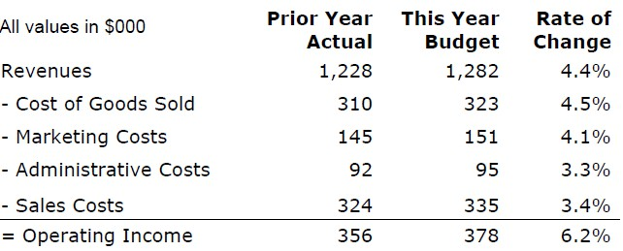
Example: Operating Budget
Helps establish agreement among management
Are targets, not forecasts
Can create tension if used for rewards

Slide 7

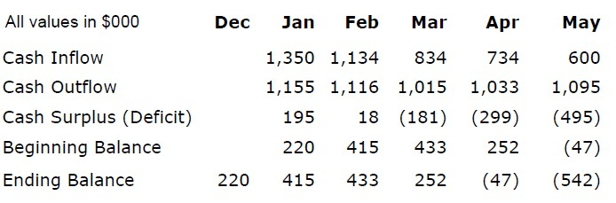
Example: Cash Budget
Cash is King
The company needs cash to operate, else it will go out of business

Slide 8

So Far ...
We’ve been talking about the Business
As a project manager you probably won’t need to deal with
Revenue projections Sales and marketing costs Organization costs
Typically on your project you will focus on:
Your project’s Return on Investment

Slide 9

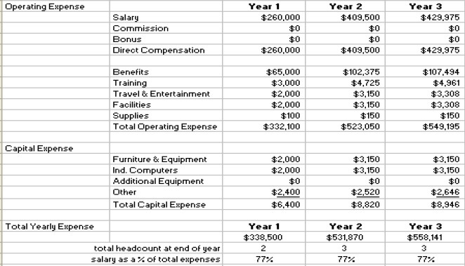
Example Project Budget Summary
Identifies what is needed to achieve project goals

Slide 10

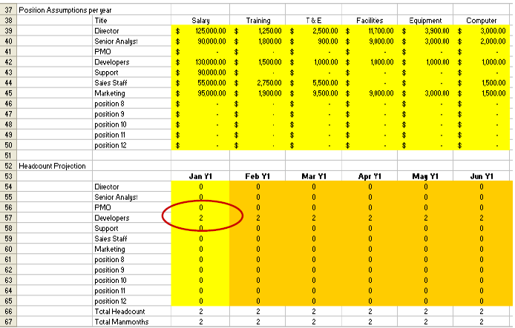
Example Project Budget Data Entry

Slide 11


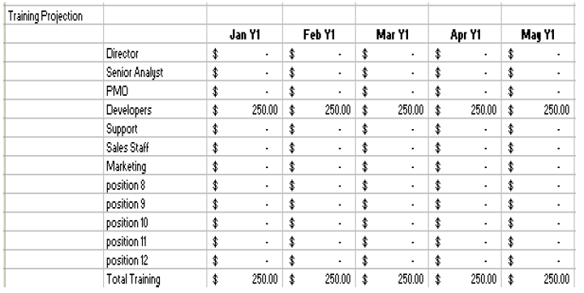
Example Project Budget Calculations

Slide 12

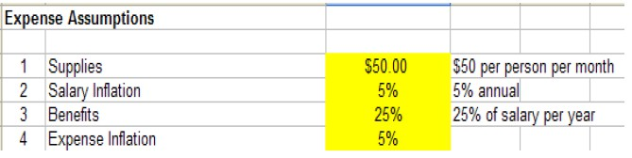
Example Project Budget Variables

Slide 13

Tips for Creating Your Budget
The provided spreadsheet is just an example
Modify it so it meets your needs
Align your project budget with the project’s Product Road Map
If there isn’t a Product Road Map, work with Marketing & Sales to create one

Slide 14



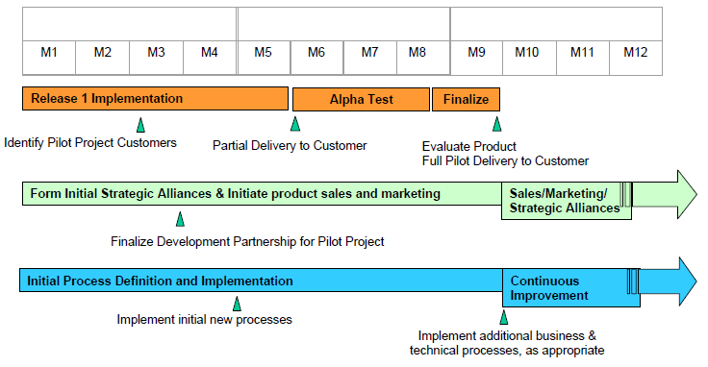
Sample Project Road Map – Year 1

Slide 15

Budgeting Approaches
Top-Down: Senior Management sets & imposes budget goals on the organization
+ Better coordination across organization
+ Removes padding
Goals may be inappropriate
Managers may feel left out of decisions
Participatory: People responsible for achieving the goals participate
+ People close to the work know what it takes
+ Involved people more likely to make it work
People may not see big picture
Performance evals may drive bad decisions

Slide 16

Tips for Effective Budgeting
Know your organization’s budget process
What are their guidelines? What is the process and timing?
Communicate with your finance person, and ask their advice
Know what is driving the people making budget decisions & address their concerns
Get buy-in from the decision makers Understand each budget line item Communicate with your team

Slide 17
Tips for Effective Budgeting
Learn and work with company priorities
Make sure your project team knows the company priorities
Make sure that requests for funds are in synch with business objectives
Determine how you will be evaluated Show how your budget generates value
If you need to reduce costs, look for activities that don’t add value for the customer

Slide 18

Slack, Padding & Sandbagging
Slack & Padding
When managers ensure that they will achieve their budgeted figures and be rewarded
Sandbagging
When managers hide the true intent of a budgetary proposal
For an organization to truly operate well, all levels of management need to operate with candor

Slide 19

Additional Financial Tools
Use these in combination to assess project value, risk and return:
Return on Investment (ROI) Payback Period
Breakeven Analysis Time Value of Money
Internal Rate of Return (IRR) Tracking Performance

Slide 20




Software Project Management
Measurement – Earned value

Slide 21

Today‟s Agenda
Do you really want to know … EVM
EVM requirements When do we use EVM EVM terminology EVM example
EVM forecasting
EVM strengths and weaknesses Summary

Slide 22

Do You Really Want to Know …
Is the project on schedule?
Is the project on budget?
When will the project complete?
How much work have we actually completed?
Would you like your information to be:
Accurate
Correct
Objective
Reasonable
Reviewable

Slide 23

Earned Value Management (EVM)
Traditional project management confuses actual costs with project progress, which isn‟t valid.
Definition: Earned Value is an objective measurement of how much “valuable work” has been completed on a project.
Using EVM, a project manager can track project progress accurately and objectively by comparing how much work has actually been completed against the amount of work planned.
Enables prediction of project completion.

Slide 24

EVM Requirements
A plan of record decomposed via a work breakdown structure into discrete „work packages‟ that:
Are deliverable based.
Provide a specific timeframe and effort for delivery.
Provide a specific cost (direct and indirect) for delivery.
Are level-oriented from high to low with each descending level representing more detail.
The scope of the entire project must be defined
in order to measure performance.
This is a problem for Agile methods as scope evolves as the project evolves.

Slide 25

EVM Requirements (2)
A baselined schedule containing all of the work packages.
A baselined budget for each work package.
A time accounting system so you can track:
Which resources
Spent how many hours
On each task
In each work package

Slide 26

WBS and EVM
The WBS needs to be decomposed to a level that facilitates EVM reporting.
Too low level: Overload of data.
Too high level: Masking of key information.
Most projects: 3 - 4 levels. Larger projects may need to go to 5 - 6 levels.
Organize work packages (and therefore WBS) around deliverables, and be sure to define done for each deliverable/work package.
E.g.: When is a software deliverable „done‟?

Slide 27

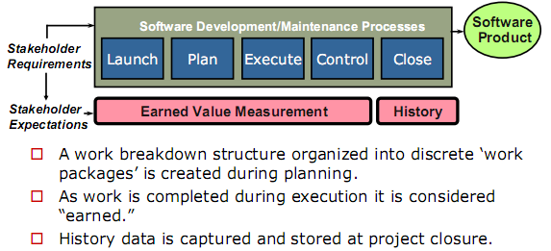
When Do We Use Earned Value?

Slide 28

EVM Terminology
In order to apply EVM the project manager must:
Have a plan of record that can accurately measure the planned costs.
Budgeted Cost of Work Scheduled (BCWS)
Be able to track the cost of completed work.
Actual Cost of Work Performed (ACWP)
Be able to establish how much “value” was “earned” by the work performed.
Budgeted Cost of Work Performed (BCWP)

Slide 29

EVM Terminology (2)
Cost Variance (CV) = BCWP - ACWP
Negative CV is “bad”
Schedule Variance (SV) = BCWP - BCWS
Negative SV is “bad”
Cost Performance Index (CPI)
CPI = BCWP / ACWP
Schedule Performance Index (SPI)
SPI = BCWP / BCWS
Budget at Completion (BAC)
BAC = Final BCWS
Variance at Completion (VAC)
VAC = BAC - EAC

Slide 30

EVM Terminology (3)
Estimate at Completion (EAC)
EAC = ACWP + estimated additional costs required to complete the project.
When trying to predict outcomes, fixing this value at an amount you know you will have available, can help show how well you must perform to meet that goal.
Independent Estimate at Completion (IEAC)
IEAC = ACWP + (BAC - BCWP)/ CPI
Projected final project cost based on current performance.
Independent Schedule at Completion (ISAC)
ISAC = Schedule / SPI
Estimated amount of time the project will take given current schedule performance.

Slide 31

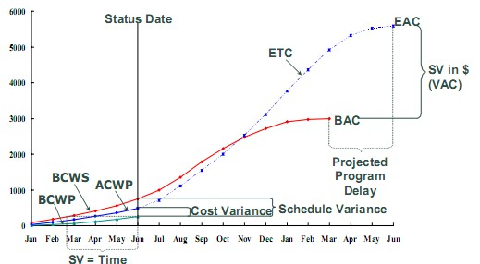
Earned Value Terminology (4)

Slide 32

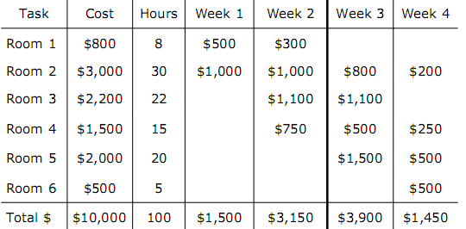
Example: Plan to Paint 6 Rooms

Slide 33

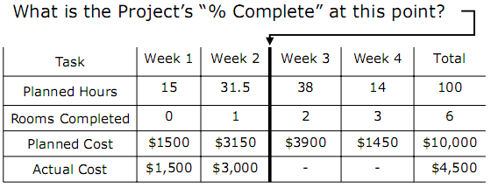
Example: Where Are We?

Slide 34
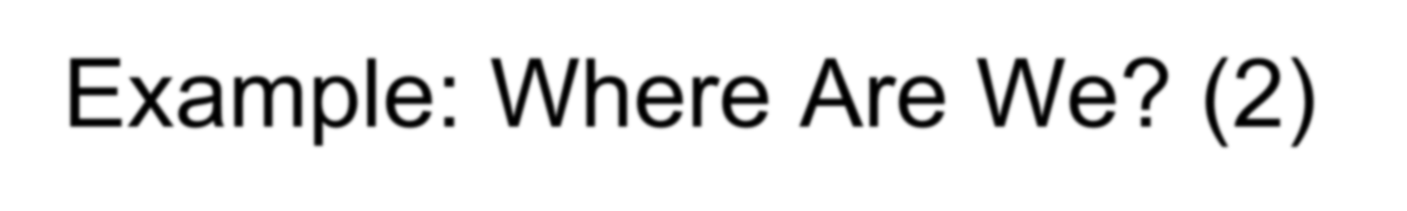
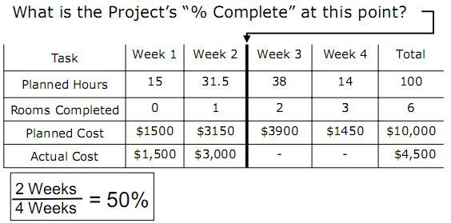
Example: Where Are We? (2)

Slide 35
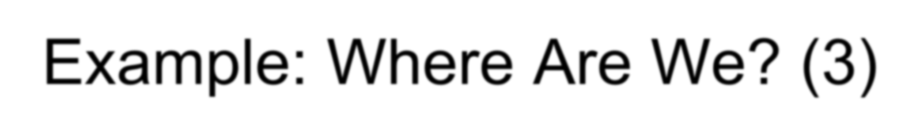
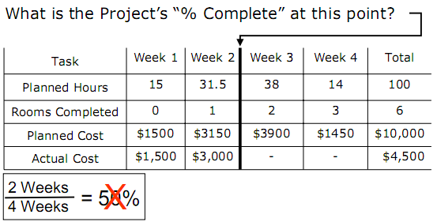
Example: Where Are We? (3)

Slide 36
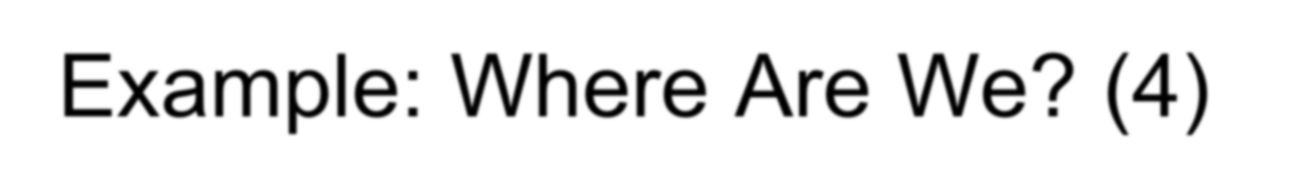
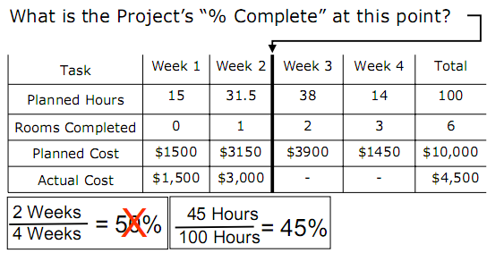
Example: Where Are We? (4)

Slide 37
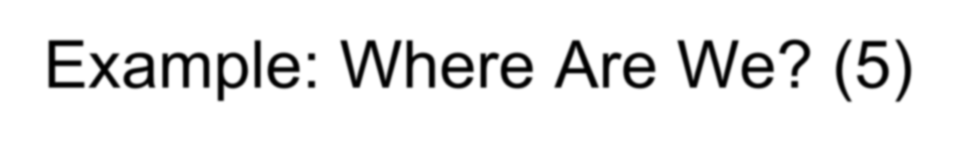
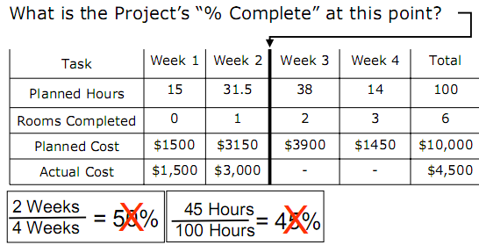
Example: Where Are We? (5)

Slide 38
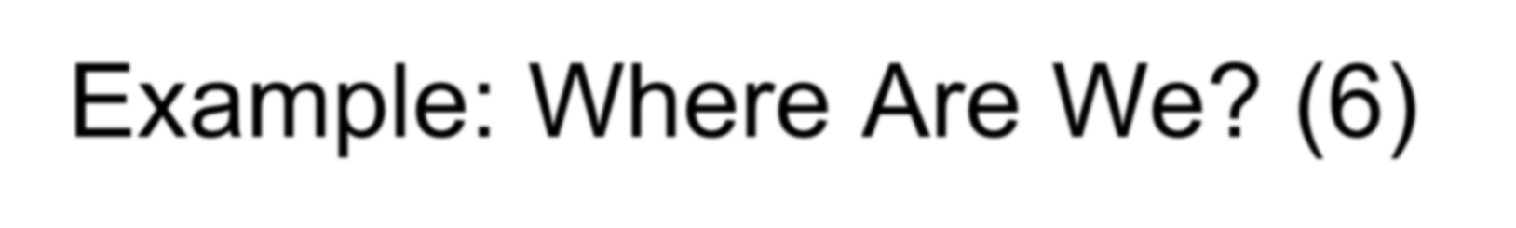
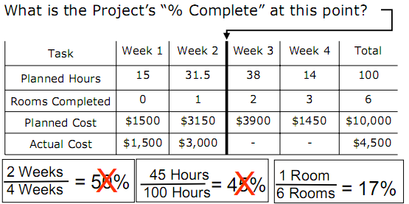
Example: Where Are We? (6)

Slide 39
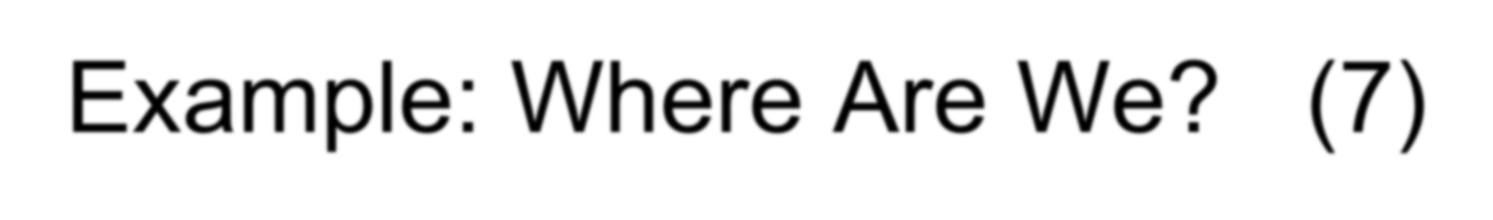
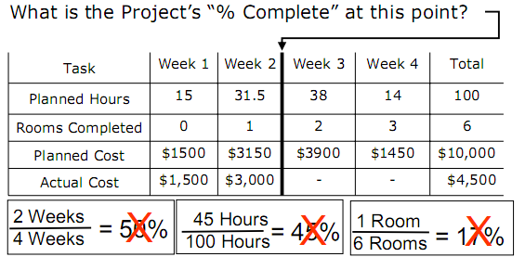
Example: Where Are We? (7)

Slide 40

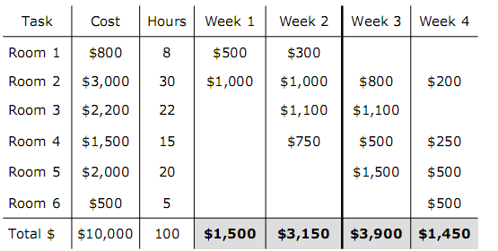
Example: The Plan = BCWS

Slide 41

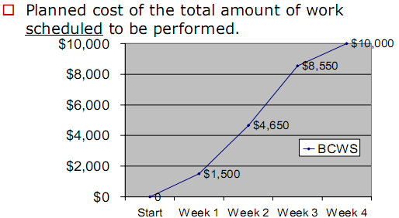
Budgeted Cost of Work Scheduled (BCWS)

Slide 42
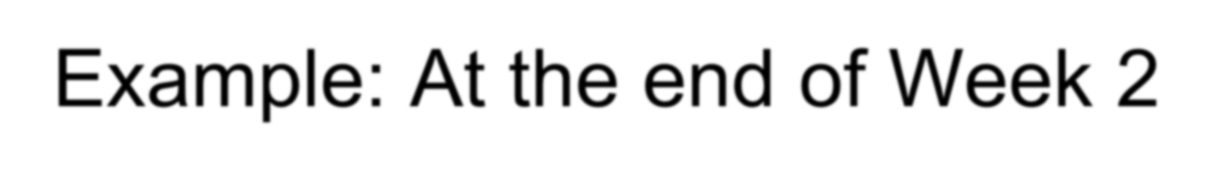
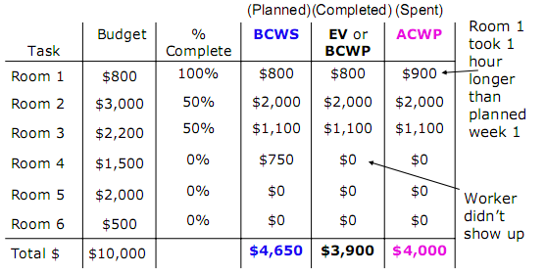
Example: At the end of Week 2

Slide 43
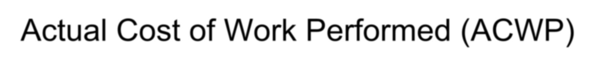
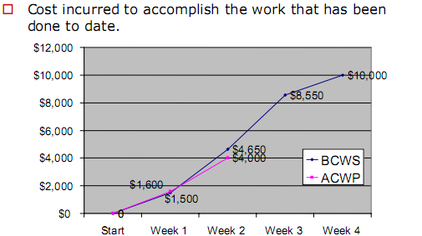
Actual Cost of Work Performed (ACWP)

Slide 44
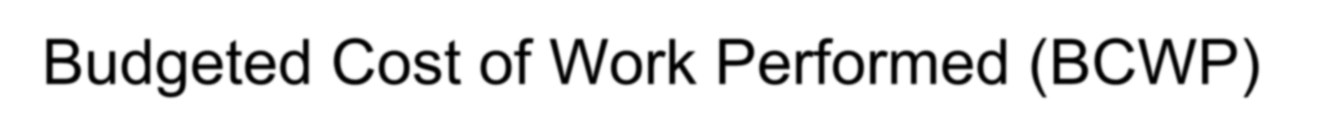
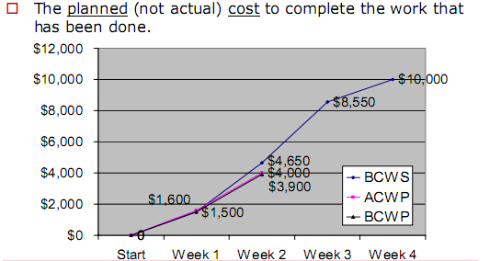
Budgeted Cost of Work Performed (BCWP)

Slide 45
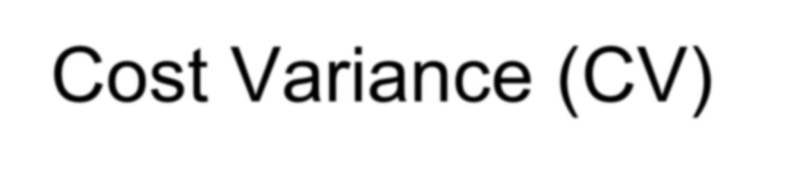
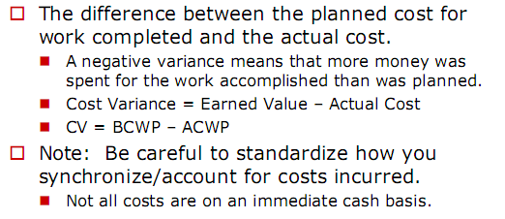
Cost Variance (CV)

Slide 46

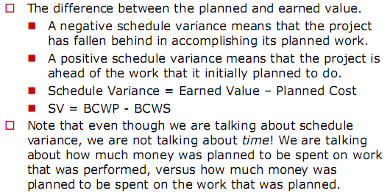
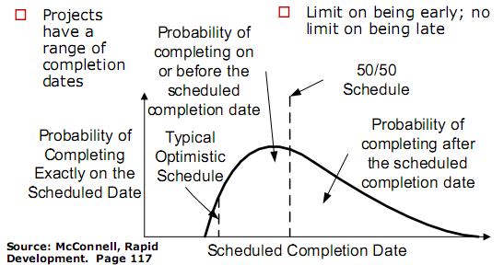
Schedule Variance (SV)

Slide 47
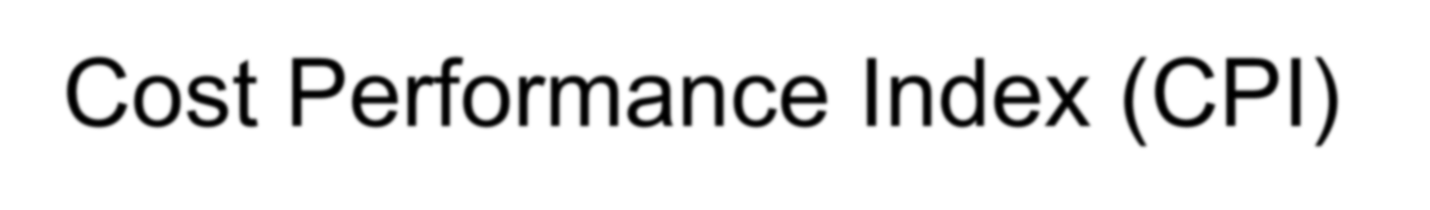
Cost Performance Index (CPI)
How much it really costs to earn the reported value:
Cost Performance Index = Earned Value/Actual Cost
CPI = BCWP/ACWP
The ratio indicates project performance:
< 1, the project is underachieving
> 1, the project is overachieving
= 1, the project is on plan

Slide 48
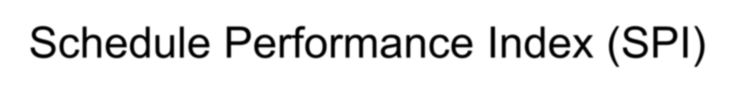
Schedule Performance Index (SPI)
How much of the originally scheduled work has been accomplished:
Schedule Performance Index = Earned Value/Planned Cost
SPI = BCWP/BCWS
The ratio indicates project performance:
< 1, the project is underachieving
> 1, the project is overachieving
= 1, the project is on plan

Slide 49
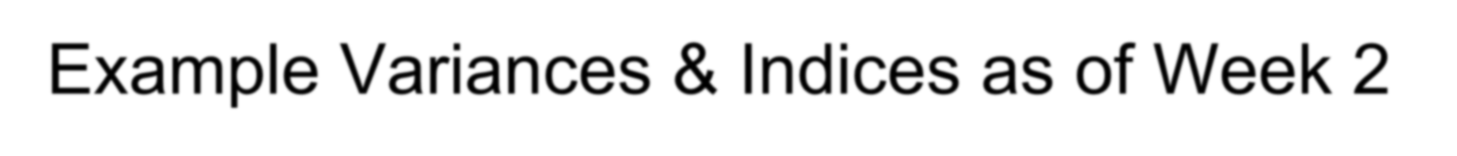
Example Variances & Indices as of Week 2
Cost Variance (CV) = BCWP-ACWP
$3,900 - $4,000 = -$100
Schedule Variance (SV) = BCWP-BCWS
$3,900 - $4,650 = -$750
Cost Performance Index (CPI) = BCWP/ACWP
$3,900/$4,000 = 97.5%
Schedule Performance Index (SPI) = BCWP/BCWS
$3,800/$4,650 = 83.87%

Slide 50
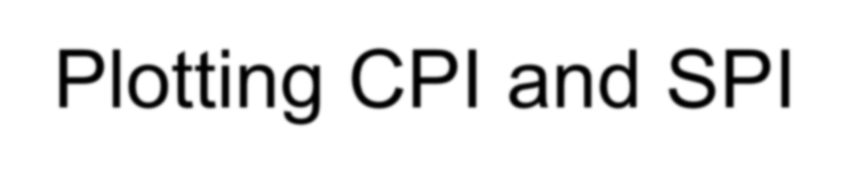
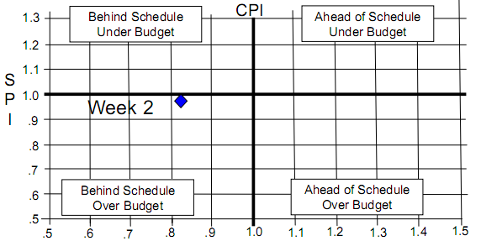
Plotting CPI and SPI

Slide 51

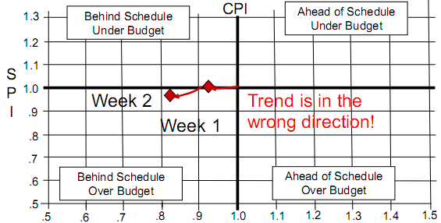
Plotting CPI and SPI Trend

Slide 52

Using EVM for Cost & Schedule Forecasts
Can statistically forecast final cost (aka Estimate at Completion (EAC)) after ~ 20% of schedule completed?
IEAC = ACWP+(BAC-BCWP)/CPI
▪ = $10,256
VAC = BAC - IEAC = $10,000 - $10,256
▪ = -$256 ($256 over)
ISAC = Project Duration/SPI = 4 weeks/.8387
▪ = 4.77 weeks
It will take 4.77 weeks and $10,256 to complete this project if current productivity continues.

Slide 53

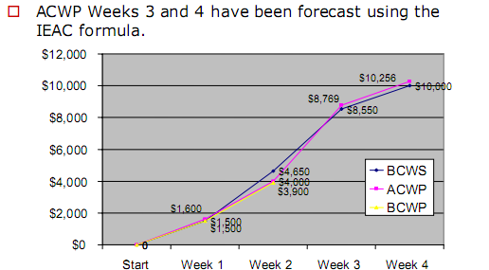
Forecast using IEAC

Slide 54

Earned Value Strengths
Objective status information. (where you are in the project?)
Access to cost data. (Are you getting “Value for your Money?”)
The ability to identify new problems and trace the source of them. (Where it is going right and where it is going wrong?)
An ability to accurately predict project cost and schedule.
(Should you continue or terminate the project?)
A more disciplined approach to the measurement and achievement of milestones. (Greater confidence that milestones have been achieved.)

Slide 55

Earned Value Strengths (2)
Improved risk management - more disciplined planning identifies and drives out more risks; accurate real time progress information leads to a better informed risk management system.
A quantitative measure of the cost of any slippage.
(How much is it really going to cost you to continue ?)
Consistent Schedule and Budget Progress Measurement Approach Across Projects and Programs.
Clear Identification of Schedule and Budget Trends.
Enables Prediction of Schedule and Cost Estimation at Complete.
Makes “Cooking the Books” Harder and More Obvious.

Slide 56

Earned Value Weaknesses
Earned Value is overhead, and requires time and resources to organize and run.
Some Earned Value implementations have been complicated and tedious, giving EV a bad reputation.
Doesn‟t work with Agile projects, although burn-down charts are similar.
“Cooking the Books” is still possible.

Slide 57

Summary
EVM is not perfect, but is the best schedule and cost tracking mechanism available.
EVM terminology takes a while to get used to.
To implement EVM you need to have a:
Proper WBS set up
Baselined budget control accounts
Baselined schedule
Time accounting system to track work
performed against tasks

Slide 58

Software Project Management
Risk Management
1

Slide 59

Course Objective
Upon completion of this course, students will have the ability to:
Understand the discipline and principles of Software Engineering.
Understand the evolution of software in industry and the global competitive trends.
Understand software process, product and services. Understand software modeling & techniques.
Demonstrate an appreciation for the breadth of software engineering.

Slide 60

Lecture Learning Objectives
Upon completion of this lecture, students will be able to:
Understand the meaning Risk Management. Appreciate the discipline of Software Engineering in
identifying and mitigating risks.
Outcomes:
Describe the process of risk management. Create a risk table for a software project.
Develop a risk mitigation plan and monitoring activities. Use a checklist to identify risks early in the project.

Slide 61

Things Happen …
Unexpected things ALWAYS happen. The requirements WILL always change.
Key members of the project team MAY leave. A key assumption WILL be proved wrong.
Needed training for new tools NOT provided.
Key resources MAY ask to support another project. Funding WILL change and Budget MAY be cut.
Hardware MAY change during implementation.

Slide 62

Risk Definition
Risks are events that cause problems when the occur.
Risk holds the possibility of a bad outcome because it involves:
Uncertainty: It may or may not happen.
Loss: If it occurs, negative consequences or loss follow.
Risk is something has not yet happened.
Requires preventive action
Issue is something that has already happened.
Requires corrective action.
Preventive action is much better than corrective action.
Risk is a potential problem, if it occurs (i.e. if it becomes 100% probable), it will cause loss or damage to the project.

Slide 63
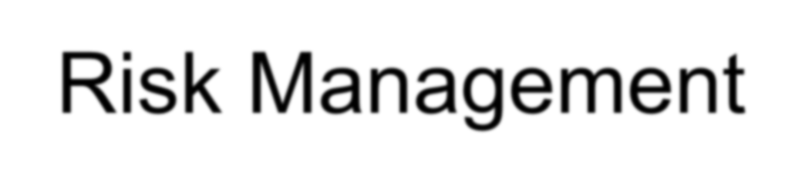
Risk Management
Risk management is a continuous disciplined process for managing uncertainty.
Risk Management is figuring out what might go wrong, then deciding on how to prevent it from happening or reduce the impact to the project.
There are three types of risk:
Project risk: Risk that threatens the project planning such as underestimates, limited time, management structure.
Technical risk: Risk that threatens the quality and timeliness of the software product such as technology obsolescence, design ambiguity, unclear requirements, testing difficulties.
Business risk: Risk that threatens the viability of the software product such as market risk (market changes), strategic risk (business changes) budget risk (company losing money).

Slide 64

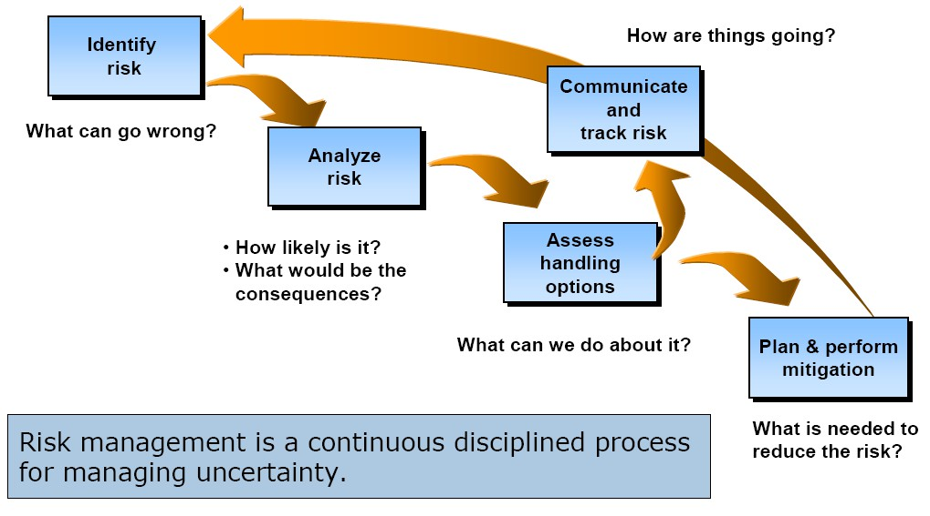
Risk Management Process: Overview

Slide 65
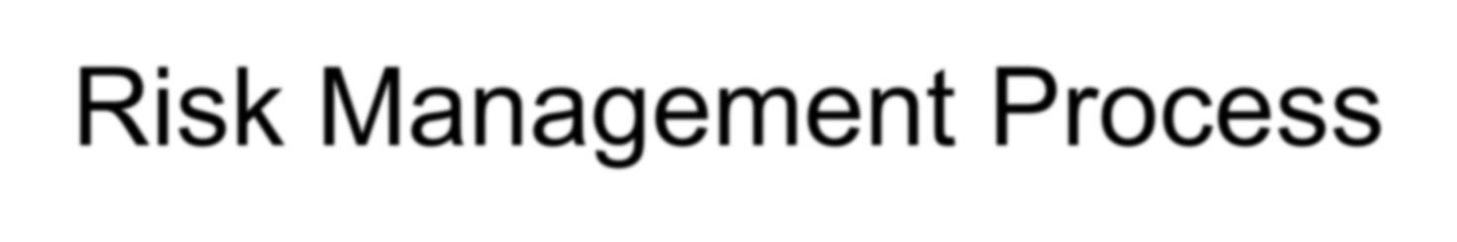
Risk Management Process
Risks are identified, analyzed, and prioritized in order to identify those most severe and must be brought to the attention of management.
Risks are analyzed to assess the handling options and obtain approval for implementation of the best solution to mitigate the risk.
Risks must be communicated to the project team for tracking.
This process starts during the planning phase of the project and continues throughout the project when new risks are identified.

Slide 66
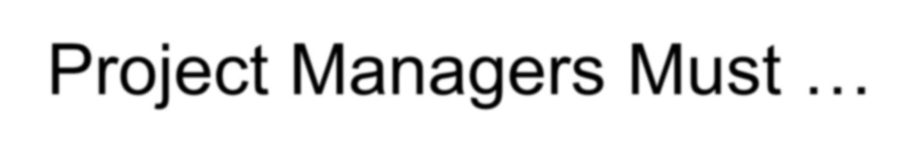
Project Managers Must …
Determine how risk will be managed and document it in the project plan.
Assign a team member to monitor potential risks and report the status on a periodic basis.
Encourage all team members to report any risk that they identify in the project.
Keep a list of all project risks listing the following attributes for each: date found, description, probability, and importance.
Create a risk mitigation plan to describe how each risk will be handled – what, when, by who and how to handle to avoid and minimize consequences, if it becomes a liability.
Assign a team member to be responsible for its resolution and a date by which the risk must be resolved.

Slide 67

Risk Identification
Risk identification is a systematic attempt to specify threats to the project plan (i.e., estimates, schedule, resources etc.).
By identifying predictable risks, project managers can take a first step toward avoiding them when possible, and control them when necessary.
At the beginning of the project, managers must create a checklist for risk identification and estimate the impact of risk on the project.

Slide 68
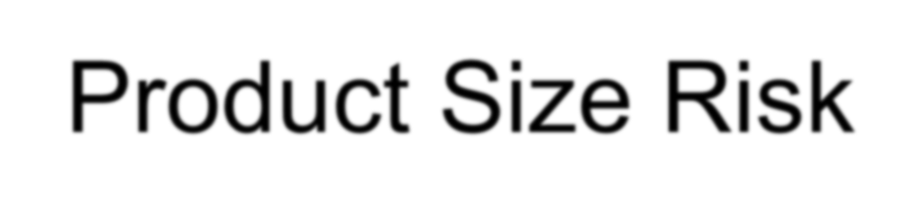
Product Size Risk
Project risk is directly proportional to project size, the larger the project, the more risk.
Examples of product size risk:
Accuracy of size estimate of the software product. Degree of confidence in estimated size estimate.
Accuracy of estimates in number of tasks, files, transactions.
Accuracy in size of database used by the project. Accuracy in number of users of the software product. Number of requirement changes for the software product. Number of reused software in the project.

Slide 69
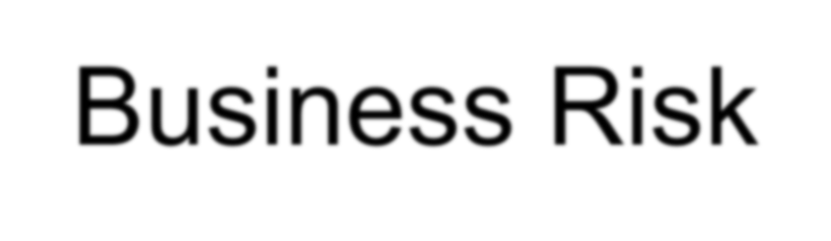
Business Risk
The following risk will have impact on the business:
Effect of software product on company revenue. Reasonable product delivery schedule.
Number of customers for this software product. Number of similar products from competitors.
Quality of the software product.
Cost associated with the development of the product.
Cost associated with late delivery.
Cost associated with a defective product.

Slide 70
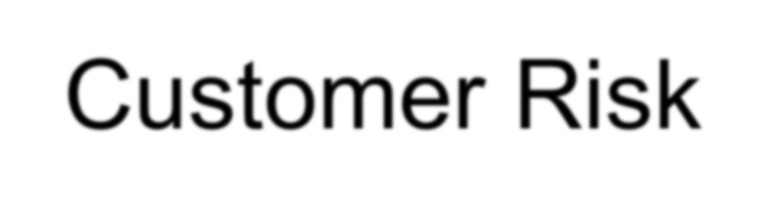
Customer Risk
Customers have different needs and are often unclear/ contradictory in communicating. This can have a profound
impact on the project team’s ability to complete the project on time and within budget.
Examples of customer risk:
Customers do not understand what is required. Customers do not have time to write requirements. Customers are not sure about the scope of the project. Customers have limited time to participate in the project. Customers are not technically sophisticated in the product. Customers do set completion time based on their needs.
Customers change their mind often. Customers are often contradict each other.

Slide 71
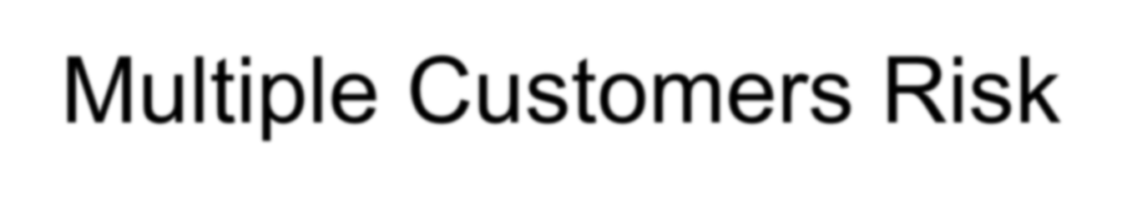
Multiple Customers Risk
Multiple customers for a project exist and their needs, behaviors and goals are not always the same. Their objective associated with cost, performance, and schedule will often be different.
These differences will often lead to contention, potentially suboptimal design solutions, funding allocation, and schedule priorities that increases project risk.
For example:
Users always favor functionality and performance when managers
prefer cost and schedule.
Mission critical users consider performance as the dominant factor and require cost and/schedule adjustments during the development to meet performance requirements.

Slide 72

Integration Risk
Integration risk is present on many projects, especially larger projects where many components, platforms and technologies must be fully integrated.
For example: Hardware/hardware Hardware/software Software/software
Network-based integration with multiple platforms etc.
The potential of integration risk is significant because most project managers do not have experience in managing large scale systems, therefore they have a tendency to underestimate integration risk or overestimate the maturity of components that require integration.

Slide 73


Technology Risk
New technology is always challenging but also risky. Following is a checklist for technology risks, if the answer to any question is “Yes” then project managers need to assess the technology risk potential.

Slide 74

Example
ABC company has introduced object-oriented (OO) technology into its organization by selecting project “X”, that has limited schedule to pilot the use of the technology.
Although many “X” project personnel were familiar with the OO concept, they had not been part of development process, and they had no experience in the technology's application.
It is taking project personnel longer than expected to learn the new technology. Some personnel are concerned, for example, that the modules implemented to date might be inefficient to satisfy project “X” performance requirements.
The risk is: Given the lack of OO technology experience and training, there is a possibility that the product will not meet performance or functionality requirements within the defined schedule.

Slide 75


Project Team Risk
The knowledge, skill and experience of project teams is critical to project success. Following is a checklist to assess project team risks, if the answer to any question is “NO”, the project manager must assess risk potential:

Slide 76

The Risk Table
The risk table provides project managers with a simple technique for risk estimation to determine the probability of the risk, as well as the consequences of problems associated with the risk.
The project team must:
List all risks in the risk column of the table.
Categorize each risk accordingly (i.e., project, technical etc.).
Analyze each risk to come up with a probability of occurrence then average them into a single probability.
Assess each risk based on impact to the project on: performance, cost, schedule or support to give a final evaluation (i.e., Critical, Severe, and Marginal).
When complete, these risks can be sorted by probability and impact then the project, using risk priorities table, the manager can focus attention on the high probability, high impact risks.

Slide 77


Example Of Risk Table

Slide 78

Risk Management Principles
The risk management process must be planned early.
All project team members, managers, and stakeholders must work
together to mitigate risks.
Risk management is an ongoing process with continual monitoring and reassessment.
Communication and feedback are an integral part of all risk management activities.
All aspects of risk management must be documented.
A set of success criteria is defined for all cost, schedule, and performance elements of the project.
Metrics are defined and used to monitor effectiveness of risk management.
An effective test and evaluation program is planned and followed.

Slide 79

Risk Planning
Risk planning includes developing and documenting a structured, proactive, and comprehensive strategy to deal with risk.
Key to this activity is establishing methods and procedures to do the following:
Establish the risk management process Identify and analyze risks
Develop risk-handling plans Monitor or track risk areas
Assign resources to deal with risks

Slide 80

Risk Handling
Risk handling is the process that identifies, evaluates, selects, and implements options for mitigating risks.
There are two approaches:
Reduce the risk itself by creating a change in current conditions to lessen the probability of occurrence.
Reduce the negative impact to the project if the risk condition should
occur. For example:
Improve testing and software inspection procedures to reduce the risk of software failure during operation.
Provide a call center for handling customer inquiries if the software failure should occur.

Slide 81

Risk Monitoring
Risk monitoring is the process of continually tracking risk and the effectiveness of risk handling options to ensure risk conditions remain under control.
This is done by:
Knowing the baseline risk management plan. Understanding the risk and the risk handling options. Establishing meaningful metrics.
Evaluating project performance against the established metrics plans
and expected results throughout the acquisition process.
Continual monitoring also enables new risks to be identified if they become apparent over time.
Monitoring further reveals the interrelationships between various risks.
The monitoring process provides feedback into all other activities to improve the ongoing, iterative risk management process for current and future projects.

Slide 82

Risk Documentation
Risk documentation is essential for the organization. It should consist of all data of risk management plans, assessments, handling information and results of risk management activities.
Risk documentation provides a knowledge base for risk management in future projects. Documentation should include:
Risk management plans.
Project metrics to be used for risk management. Identified risks and their descriptions.
The probability, severity, impact, prioritization of all known risks, including newly identified risks, plan changes, etc.
Description of risk handling options selected for implementation.

Slide 83


Simple Risk Analysis

Slide 84

The Value Of Risk Management
An effective risk management process can:
Eliminate or minimize exposure to many risks.
Identify potential problems while they are easier to fix (i.e., fewer hours, fewer resources, less pain).
Help determine best course of action from the start. Guide allocation of limited resources to priority needs.

Slide 85

Risk Management Checklist
Risk is a product of the uncertainty of future events. Since project managers cannot avoid risk, they must find ways to reduce risk or its impact. Yet, risk cannot be completely eliminated because it cannot be identified before hand.
To support project managers to identify risk as early as possible, Carnegie Mellon University recommends the use of risk management checklists when you plan your project.
The following checklist is provided to assist you in risk
management. If you answer “NO” to any of these questions, you should examine the situation carefully for the possibility of greater risks to the project.

Slide 86



Risk Management Checklist - 1
Do you have a comprehensive approach to risk management?
Do all stakeholders or their representatives participate on your risk management process?
Do the stakeholders support process-driven software engineering that incorporates adequate planning, requirements analysis, design, and testing?
Is the project manager experienced with similar projects?
Is the project manager dedicated to this project, and not dividing his or her time among other efforts?
Are you implementing a proven development methodology?
Are requirements well defined, understandable, and stable?
Do you have an effective requirements change process in place?
Does your project plan require that project managers track and trace requirements through all phases of the project?

Slide 87



Risk Management Checklist - 2
Are you implementing a known and proven technology?
Do you have multiple vendors for hardware equipment?
Is your hardware equipment stable?
Can all hardware equipment be brought easily to the market?
Are all external/internal interfaces for the hardware defined?
Are key positions in your project staffed with qualified personnel?
Are software developers trained and experienced in their respective evelopment disciplines (i.e., systems engineering, software engineering, language, platform, tools, etc.)?
Are software developers experienced or familiar with the technology and the development environment?
Are key personnel stable and likely to remain in their positions throughout the project?

Slide 88

Risk Management Checklist - 3
Is project funding stable and secure?
Are all costs associated with the project known?
Are development tools and equipment used for the project dependable and available in sufficient quantity?
Are the developers familiar with the development tools?
Do the size and effort estimates seem reasonable?
Is the schedule realistic to support an acceptable level of risk?
Is the project free of special constraints?
Is the testing approach appropriate for the system components?
Have acceptance criteria been established for all
requirements and agreed to by all stakeholders?

Slide 89

Risk Management Checklist - 4
Will there be sufficient equipment to do integration and testing?
Has sufficient time been scheduled for system integration?
Can software be tested without special test equipment?
Does the group developing the system stay in one location?
Are subcontractors reliable?
Is project work being done by other groups over which you have no control?
Are development and support teams all located at one site?
Has the project team worked on a large effort like this before?

Slide 90

Summary
Risk is an undesirable situation which may, or not, occur.
Risk management is a systematic decision-making process that:
Efficiently identifies risks.
Assesses risk levels.
Handles them effectively to achieve business goals, including mitigation when appropriate.
Risk identification is done continuously with appropriate management visibility and participation.
Risk analysis identifies significant items for manager’s attention.
Risk mitigation plans should be included in project plans, and each mitigation action should include associated risk reductions.
Preventive action is cheaper than corrective action, therefore handle the risks before they turn into problems or issues.

